Slide 1
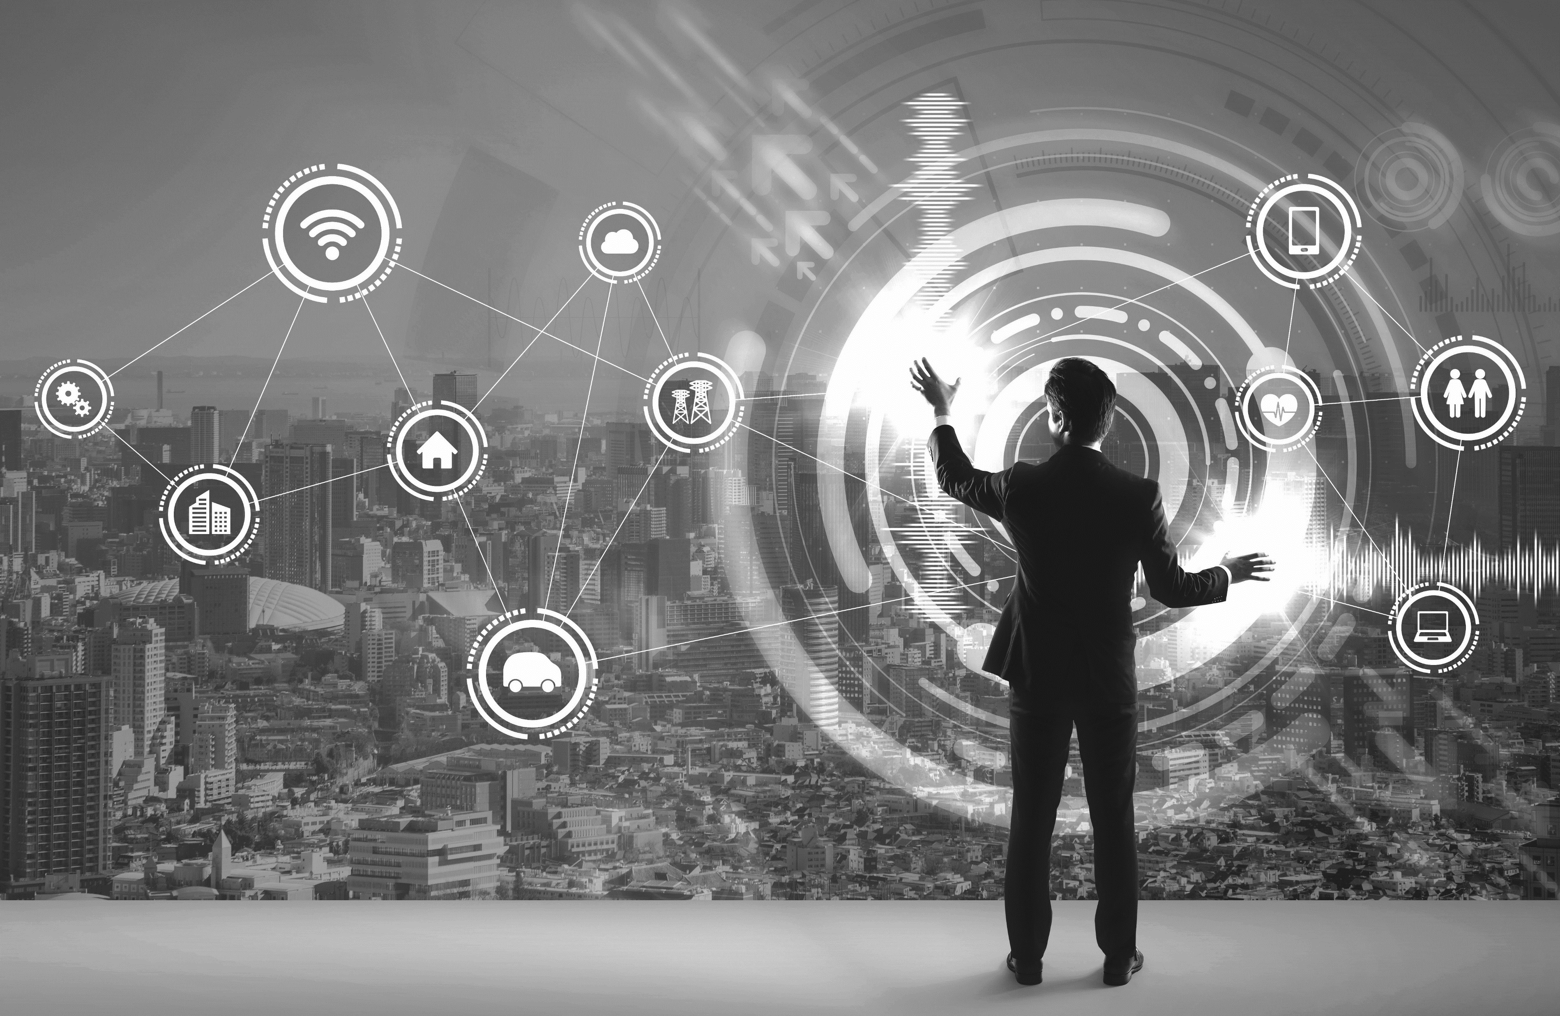

Our EXPERIENCE
For your DIGITAL
TRANSFORMATION
daniele.casson@beantech.it

Slide 2

Agenda
Big Data and Context
Lambda architectures
MapReduce to Spark
Data Structures
Streaming Caveats
What’s next?

Slide 3
A big data APPROACH
Identify the business needs
Analyze your data
Define a solution to answer the business
Find the architecture that fits best your solution
Prepare to swear…

Slide 4
Do you really have BIG DATA?
«Big data is like teenage sex:
everyone talks about it,
nobody really knows how to do it,
everyone thinks everyone else is doing it,
so everyone claims they are doing it».
Dan Ariely, Duke University
Notes:
Dan Ariely, a famous professor in Duke University. As you can see, he was very critical about big data processing and what big data really is in real world.
Anecdote – first interview in beanTech
This is only to say that despite all the theories about the multiple «V»s to identify what big data is, you have to be conscious that in real life it’s very important to be critical in order to identify the best solution for your data games. Sometimes you’ll have to deal with millions of rows but it still won’t be big data and a big data architecture would be much and much expensive than necessary.

Slide 5
Big Data THE 3Vs CONCEPT
Data
Velocity
Real Time
Near-Real Time
periodic
Data
Volume
batch
MB GB TB PB
excel
RDBMS
semi-structured
(Web, Social,…)
Unstructured
(Video, Photo, Audio…)
Data
Variety
Notes:
Volume (since size of produced data is constantly incrementing, the estimated data produced all over the world in 2020 is 59 Zettabytes [ 1 ZB equals 1 trillion of GB])
Variety (because simple data coming from Excel or RDBMS is not enough anymore, we want to analyze text from web [imagine tweets from Twitter], videos and photos from Facebook or even from production processes as we’ll see in a minute and many more data types)
Velocity (in fact we want to get insights faster and faster [think about a recommendation engine while you’re shopping on Amazon, eBay or whatever])
Some of the theories through the data anlytics world suggest to add two more Vs for Veracity and Value (which stand respectivley for accuracy and meaning that we want to extract from our tsunami of data).
[slide]

Slide 6
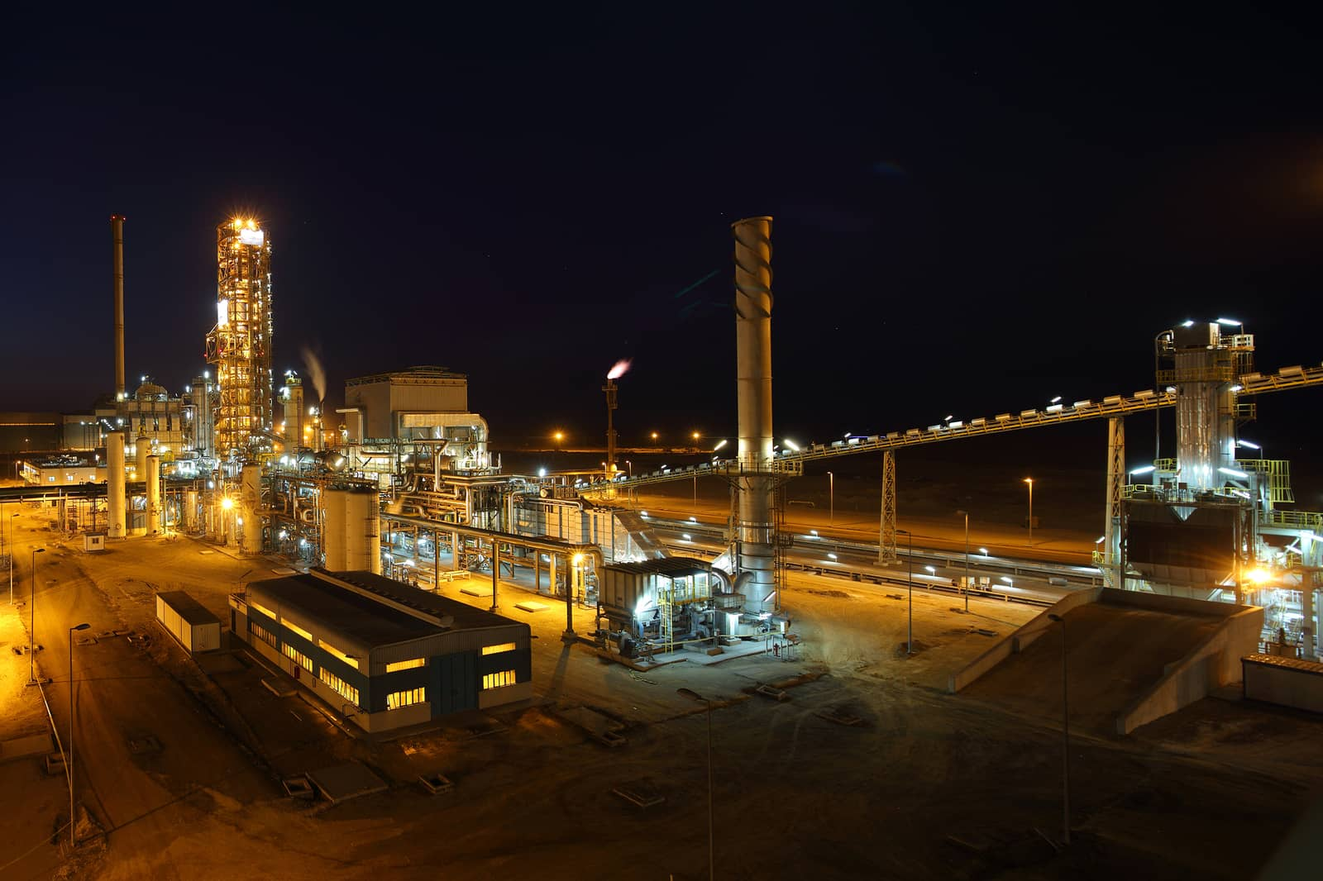
Context
Notes:
Context overview
Every machine in every plant generates TB of data with thousands of variabiles that can reach a sampling frequency of 250 milliseconds
From the field we need to get and store all the measurements in order to:
Monitor the production
Analyze all the process variables
Make quality checks and predictions
Predict anomalies or failures
Stakeholders. Different informations at different speeds

Slide 7


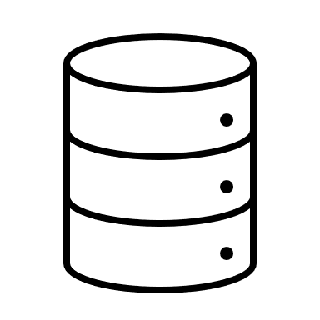

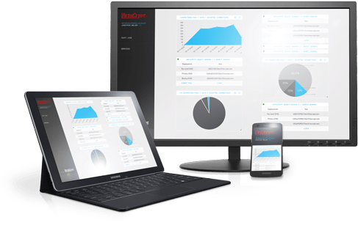

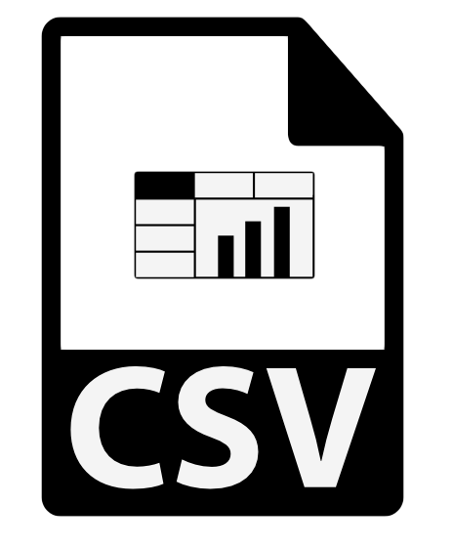



Lambda ARCHITECTURE
Hot Path
Real-Time View
{ Stream }
Real-Time View
Real-Time View
Cold Path
Batch View
{ Batch }
Batch View
Batch View
Notes:
Nathan Marz described lambda architecture as a solution for beating the CAP theorem.
- Consistency (every read receives the most recent write or error)
- Availability (every request receives a non-error response regardless the consistency)
- Partition tolerance (it means that the system keeps going on despite some message being lost during the failure).

Slide 8
3-ways Lambda ARCHITECTURE
Hot Path
Real-Time View
{ Stream }
Real-Time View
Real-Time View
Warm Path
Cold Path
Batch View
{ Batch }
Batch View
Notes:
Some enthusiats love to add an additional layer called «Warm path» but the only differences from the original lambda architecture are:
- The freshness of data: minutes instead of seconds (for hot path) or hours (for cold path)
Retention is set to months instead of days (fot hot) or years (for cold)
Purpose. In fact warm path is mainly used for data exploration while hot and cold are respectively used for data viewing and data manipulation.
As you can see from the schema, the warm path is a subset of the cold path because it works with micro-batches and lets a data engineer to do a deeper modeling on data than what it’s possibile in the hot path.

Slide 9


Hot PATH
Hot Path
Real-Time View
Real-Time View
Real-Time View
Warm Path
Cold Path
Batch View
Batch View
Notes:
Today we will focus on the Hot Path and… spoiler… we will talk about Spark’s way to meet the needs to process real and near-real time data with its Streaming module.

Slide 10
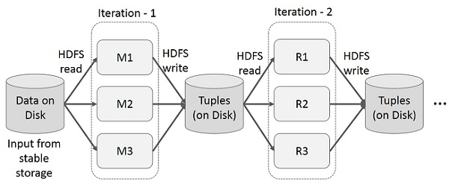
MapReduce
It is a parallel processing system for managing huge amounts of data, following the divide et impera strategy.
MapReduce paradigm
For each batch:
Read from storage
Map
Write to storage
Drawbacks of this approach
too many I/O operations
not ideal for streaming
Notes:
In the first decades of big data computing MapReduce was the reference paradigm with Hadoop implementation.
[read MR definition]
How MR works
Too many I/Os for streaming

Slide 11
Streaming
Kafka Streaming
Provides low latency (ms)
Best for kafka-to-kafka applications
Advanced fault tolerance
Hyper-scalable
Spark Streaming
Higher latency (seconds)
Best solution for different systems integration
Fault tolerant too
Scalable too but requires more resources
Code flexibility (same code for streaming and batch)
Notes:
Kafka Streaming is the fastest
In fact [… read slide ...]
What it leaks in kafka architectures usually is the processing part but we do have to manipulate informations
What I REALLY want to be sure of, is that business users can access the GOLDEN informations at the right time (and the right time could NOT be real time, in most of the cases near-real time will be enough). So, if you don’t need the speed of light, Spark will be more than fine.
The second leak in Kafka streaming because, since we want to persist the data once the stream is processed/cleaned/enriched to make it usable in the future and since we’re hopefully working with big data, I dare you to store 5 or 10 years of historical detections from industrial sensors in a queue.

Slide 12



Storage types CASE HISTORY
Web Portal
Streaming flow
Batch flow
Big Data
Storage
…
W.O.R.M.
Notes:
Back to the context I described before, we usually offer to our customers a web portal that includes several modules. Typically one for ex-post analysis with batch manipulated data, one for process analysis with fast moving data and frequent interactions by the users and more…
When talking about streaming there is an important aspect to consider:
Will my data arrive ready to be consumed all-in-once or do I have to expect chunks of delayed data?
In steel making a single product can be kilometers long and several measurements are made during the whole process
This aspect impacts on where to store my «live» data in the time that passes between the first and the last measurements because in THAT interval, I want to present to the final user the state of the production but I have to consider that my data will need to be updated many times.
WORM (write once, read many [times]). So, update is usually a tricky operation to perform.

Slide 13
Storage types CASE HISTORY
Web Portal
Streaming flow
Streaming flow
Batch flow
Big Data
Storage
…
W.O.R.M.
Notes:
additional layer with a document-based DB optimized for updates and fast response for RT dashboarding.
Retention… 6 months
Show data as soon as we receive but write once the document in the data lake avoiding multiple updates
At this point the question is… how does Spark fit into this?

Slide 14
Spark
It is an open-source distributed general-purpose cluster-computing framework, like MapReduce.
In-memory computation
As a result, it is capable of running programs up to 100x faster than MapReduce, making it suitable for real-time computation.
Lazy evaluation
It means that the execution of transformations isn't triggered until there is an action that needs results. Therefore, the sequence of operations are analyzed for optimization.
Notes:
Spark started as a research project in 2009 and moved to Apache Software Foundation in 2013 but the first (open source) stable release was distributed in 2014.
In-memory computation -> Spark 100x faster than MR
And lazy paradigm
Transformations and Actions
lazy paradigm, it means that I can apply any Transformation on my dataset but not a single bit is moved until I will perform an Action. This approach allows Spark engine to automatically optimize the execution plan before doing anything. As a result, our code will be even faster.

Slide 15
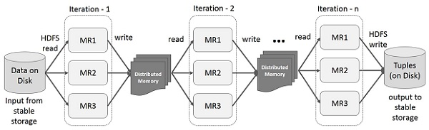
RDDs
RDDs evolution
Notes:
Resilient Distributed Datasets
3 main properties:
immutable (aka read-only) this means that when I perform a Transformation on a collection calling an Action, the output will be a different RDD.
Distrubuted. It means that each dataset is divided into logical partition in order to be processed by different nodes and then rejoined in a brand new RDD
And of course they are collections of elements.
RDDs were created to boost MapReduce performances because each intermediate step of every operation uses Distributed Memory to store partial data instead of leaning on the storage.

Slide 16
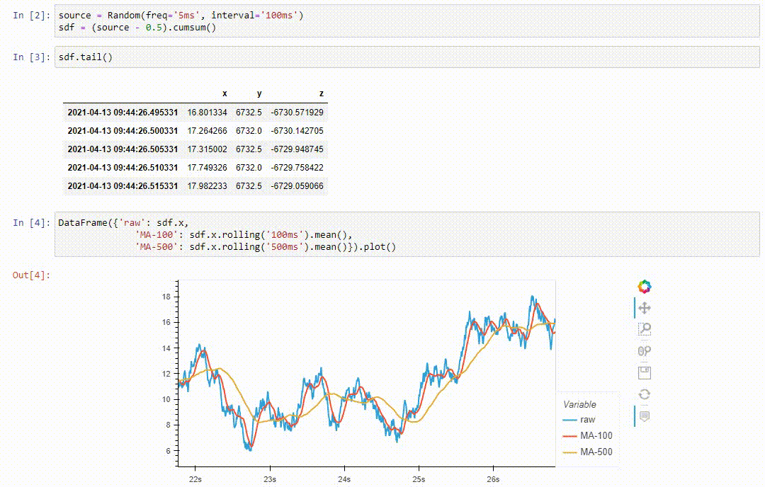
Streaming

Slide 17
Spark STREAMING
DStreams
Data
Sources
DStream
RDD @ time 1
RDD @ time 2
RDD @ time 3
data from
time 0 to 1
data from
time 1 to 2
data from
time 2 to 3
Ref. Spark 1.6 documentation
Notes:
The basic concept was to reduce the size of the batches (calling them microbatches with not much fantasy) and work with a series of RDDs concatenated in abstract structures called DStreams.
[slide, slide, slide]
In a typical flow, Spark polls the source for new data every interval (which is defined in the application) and then creates a batch with the new received data. Every batch creates in fact a new RDD that is appended to the Dstream

Slide 18
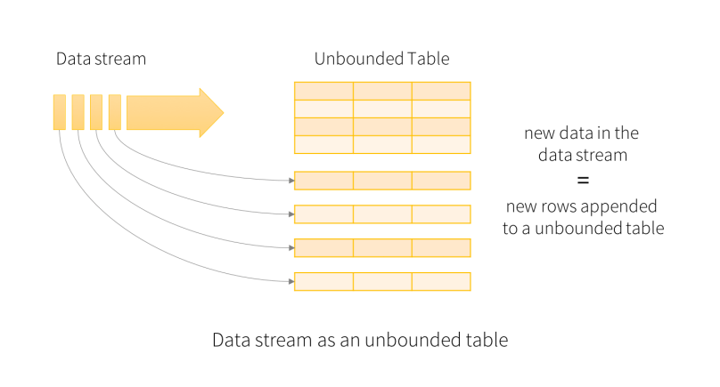
Dataframes and Structured STREAMING
 | Col 1 | Col 2 | Col 3 | Col 4
Row 1
Row 2
Row 3
Row 4
Row 5
Row 6
Notes:
With the second version of Spark, Dataframes came to light within the SparkSQL module as Datasets.
Dataframe <-> tables
[slide]
Output appended to an ever-growing dataframe
RDDs used to focus on how to do things instead of what the output would be and optimiaztion could be performed analyzing the execution plan but you had to manually adapt your code to a specific situation.
Dataframes, instead, focus on what the result of all the transformations would be, and automatically optimize the execution plan in order to minimize the effort needed to reach the output.

Slide 19
RDDs execution plan
RDD
[
(‘New York’, 10),
(‘Chicago’, 15),
(‘Miami’, 8),
(‘New York’, 2),
(‘Chicago’, 7),
(‘Miami’, 19)
]
Filter 1:
City == ‘Miami’
Filter 2:
Degrees > ‘10’
…
Notes:
Explain the flow
in older Spark versions the execution flow would reflect exactly the order of operations we wrote in our code without taking care of optimization.
The result was that the creation of new RDDs at every filter, consumed more and more memory.
Imagine this inefficiency in a situation where we have to read and process hundreds of variables every second. This is neither acceptable nor sustainable.

Slide 20




Flow CONTROL
Data & Events
Streaming Analytics
Validation
Data Lake
AI & Reporting
Notes:
It would be very nice if, once up & running, the whole system would move forward without turning and looking back. Unfortunetly things don’t ever go as expected and sometimes there’s something that goes terribly wrong.
[slide]
Today we’re focusing on streaming but we have to keep always in mind that this is only a half of the architecture and we have to ensure that the final users will consume clean, correct and consistent data whether they do real-time monitoring or analyze the process afterwards.
Protect from failures

Slide 21
Checkpoints & State
Checkpoint
State
Checkpoint
Aggregations
For example min, max, avg, sum…
stream
stream
Configurations
Operations
Incomplete computations
stream
stream
State
Notes:
Stateful Streaming
2 types of State:
[slide]State of progress (implemented by checkpoints) which can be used both in stateless and stateful processing.
As you can see, it’s used most to save configurations, operations list to be applied to our datasets and incomplete computations so I can restart from a consistent point whenever I need to reprocess my data for any reason (both crash or output correction)
[slide]State of data which exists only in stateful processing.
It is used, for exmple, for saving the output of operations like aggregating average of records by key and other.

Slide 22

Windows
10:00
11:00
12:00
10:02 | Piece 1 | Steel temp | 1140
10:02 | Piece 1 | Torque | 22.6
10:04 | Piece 1 | Steel temp | 1152
10:04 | Piece 1 | Torque | 22.5
… | … | … | …
11:46 | Piece 2 | Steel temp | 1137
11:46 | Piece 2 | Torque | 22.2
11:48 | Piece 2 | Steel temp | 1163
11:48 | Piece 2 | Torque | 22.9
… | … | … | …
Notes:
[slide]
What we’ve done until now is read data, append new rows to an ever-growing dataframe and process it continuously while saving the state of our computations on the disk.
[slide]
Data coming from the field becomes too much to be computed between triggers.
Let’s assume that our production line spits out a product every hour (and now we have our timeline)
[slide]
we don’t need to RE-compute all the metrics forever and ever appending new measurements coming from the field to old products already parsed.
Explain scenario with data points and aggregations

Slide 23
Window TYPES
Tumbling windows
Time 1
Time 2
Time 3
Time 4
Time 5
Time 6
Sliding windows
Time 1
Time 2
Time 3
Time 4
Time 5
Time 6
Notes:
[slide]
Tumbling vs Sliding windows
sometimes we could prefer to focus on the process itself regardless the single product has exited the line or not.
Explain the sliding example

Slide 24
Late DATA
Window 1
Window 2
Window 3
10:06 | 1143
11:18 | 1144
11:45 | 1148
12:16 | 1154
11:33 | 1131
10:38 | 1149
10:07 | 1150
10:29 | 1137
Result Table
10:00 – 11:00 | 1147,3
11:00 – 12:00 | 1146
12:00 – 13:00 | 1154
10:00 – 11:00 | 1144,75
11:00 – 12:00 | 1141
12:00 – 13:00 | 1154
10:00 – 11:00 | 1146
11:00 – 12:00 | 1146
10:00 – 11:00 | 1146
11:00 – 12:00 | 1146
12:00 – 13:00 | 1154
10:00 – 11:00 | 1146
10:00 – 11:00 | 1147,3
11:00 – 12:00 | 1146
Notes:
Sometimes could happen that one of the sensors temporarily looses the connection to the IoT Hub (that is the collector of data coming from the field) and delays sending its data.
So, what is late data?
In this example every window computes the average of the data received
[slide]
Late event is an event that with a timestamp smaller than max event time of prev window
[slide, slide, slide]
Ever-gorwing output instead of input

Slide 25
Watermarks
Watermark value = 40 mins
Watermark
Max Event Time
12:05
12:45
Too Late Events
Late Acceptable Events
Acceptable Events
Notes:
watermarks is a sort of an «auto cleanup» of the State.
Watermarks are time-based thresholds and they are calculated as:
Max event time in window – watermark value
Explain [slide, slide, slide]

Slide 26
Watermarks
Watermark value = 40 mins
Window 1
Window 2
Window 3
10:06 | 1143
11:18 | 1144
11:45 | 1148
12:16 | 1154
11:33 | 1131
10:38 | 1149
10:07 | 1150
10:29 | 1137
Result Table
10:00 – 11:00 | 1146
11:00 – 12:00 | 1146
10:00 – 11:00 | CLOSED
11:00 – 12:00 | 1141
12:00 – 13:00 | 1154
10:00 – 11:00 | 1146
10:00 – 11:00 | 1147,3
11:00 – 12:00 | 1146
Drop Event < 09:58
Drop Event < 11:05
Notes:
Let’s see the exemple we saw before and try to apply watermarking by setting a watermark value of 40 minutes. In the first window we receive two messages and compute the average.
[slide]
During the second window we recieve also a late event and, since our watermark is 10:38 – 40 = 09:58, our event is acceptable and Spark updates the state.
[slide]
With the third window we receive two late events but, since our watermark is now 11:45 – 40 = 11:05, the one with timestamp 10:29 is considered too old because it’s smaller than our watermark and dropped. The row tagged with timestamp from 10 to 11 is not updated in the state since that window is considered closed.

Slide 27
DEMO

Slide 28


Spark STRUCTURED STREAMING
Train model with live data
Prediction with trained model
MLlib
Streaming Data Sources
Spark Streaming
Spark SQL
Data Storage
Static Data Sources
Process with dataframes
Interactively query with SQL
Notes:
Explain the schema
But the most interesting thing is the chance to use MLlib, the Spark machine learning module, to continuously train models with incoming and updating datasets in order to make predictions on live data.
In a complete flow we would both use predictions for direct visualization or alerting and for data enrichment as a completion for the rest of the informations we processed and wrote to our sinks (databases, data lakes, queues or whatever).

Slide 29
Close the CIRCLE
Hot Path
Real-Time View
{ Stream }
Real-Time View
Real-Time View
Warm Path
Cold Path
Batch View
{ Batch }
Batch View
Notes:
At some point it’s useless to analyze late data because we can’t do anything more since the product is out of the line.
The circle is closing and at this point we reunite with the Cold Path
The important thing is that we did all what we could to prevent and possibly correct any problem as soon as possible. If we couldn’t make it, we still have the data to understand what went wrong and avoid a similar situation in the future.

Slide 30
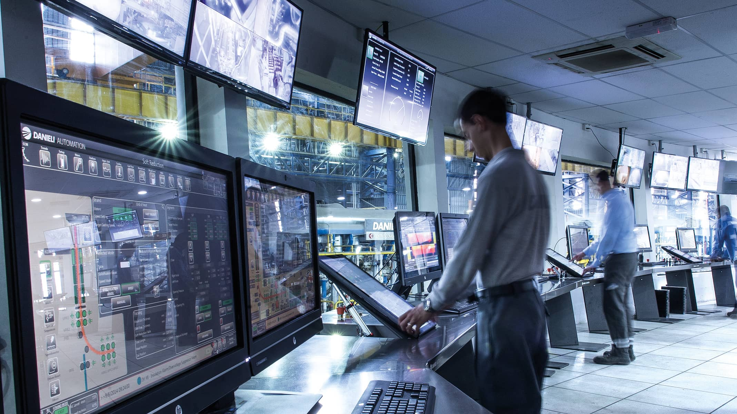

BUSINESS ANALYTICS PER IL MANUFACTURING
COLLABORATORS
2019 REVENUES
419
195 ML
COUNTRIES
Italia – Slovenia – Croazia – Tailandia – Cina - USA Europa – Canada – Russia - Vietnam – India - Taiwan Giappone
CASE NEEDS
Develop a vertical platform for metal industry built to ingest, store and anlyze both process data and business data.
The main focus had to be on the production cycle starting from order acquisition to delivery through all the transformation phases of the raw material to final product.
The solution we provided is at the forefront and embraces the Measure – Gain Insights – Improve philosophy..
Notes:
tiny imperfection in a steel bar could impact the strength of the final product.
Danieli Automation is a big company that produces machines for plants that work several types of steel products. It’s a big multinational company that digitally transforms manufacturing plants all over the world. Their clients produce components for several industries like automotive, oil & gas and others.
Now, Imagine if a defective steel bar arrives to a car factory and imagine if the chassis of your car would blend with minimal stresses due to some holes on the streets.
It’s essential to check meccanical properties and make correct predictions on what will be the quality of the final product even before the production starts.

Slide 31
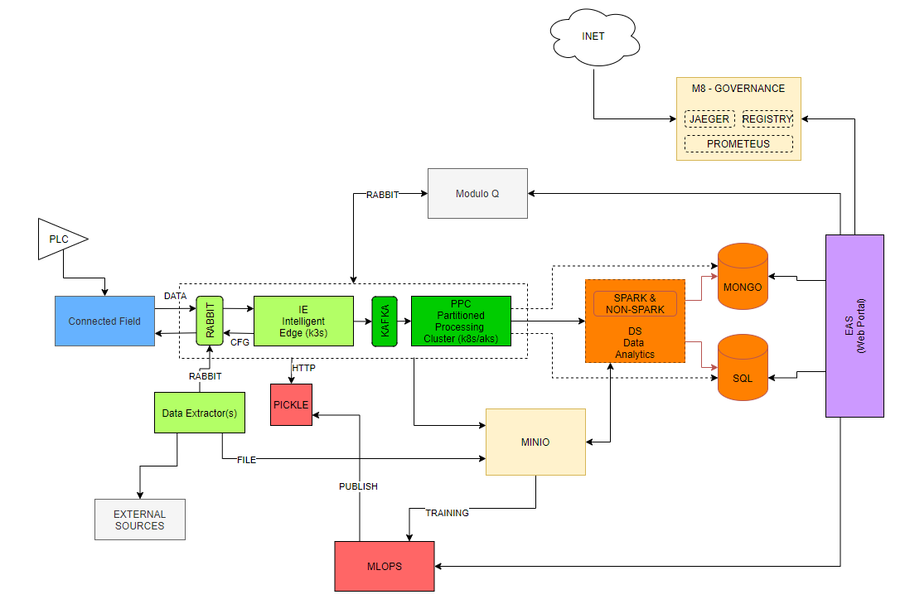
Danieli ARCHITECTURE
Notes:
This is the actual on-premises architecture we implemented with Danieli Automation. In terms of components this is also implemented for cloud solutions.
You can clearly identify 4 main components in this architecture.
[slide] the first one is the field part. All these components are meant to connect the system to the production line and retrieve all the data from the sensors and other sources
[slide] then we store all the retrieved data in the object storage in order to process them
[slide] during the whole process we use a machine learning module that constantly trains models and adapts themselves to new data. These models are used to make predictions while streaming and with batch processing
[slide] the last component represents the last mile of the whole architecture. I’m talking about the portal in wich we can embed for example Power BI reports, Tableau dashboards, custom web apps and much more. Here we have several vertical applications used by the stakeholders to make the most desparate analysis on process, energy consumption, products and more.

Slide 32
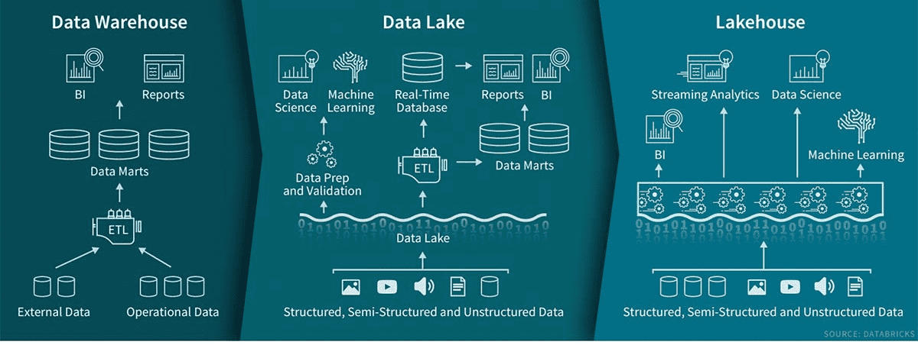
What’s NEXT?
Notes:
Courtesy of Databricks
DWH
Data Lake
Lakehouse

Slide 33

THANK YOU
For your attention
www.beantech.it
www.beantech.it/academy
www.beantech.it/blog

